Slide 1
Understanding Redox Chemistry of FMN semiquinone with DFT and MD simulation
Anar Nuruzada, Logan Kuhn, Gilbert Otoo
Notes:
Hi everyone, im .... and we'll be presenting on (title). FMN (Flavin Mononucleotide) is a cofactor that transfers electrons in enzymes and it has applications in Thyroid synthesis and Environmental Remediation. The semiquinone is a radical intermediate with one unpaired electron and we are going to be using DFT (Density Functional Theory) and MD (Molecular Dynamics) simulations to understand how it works.

Slide 2
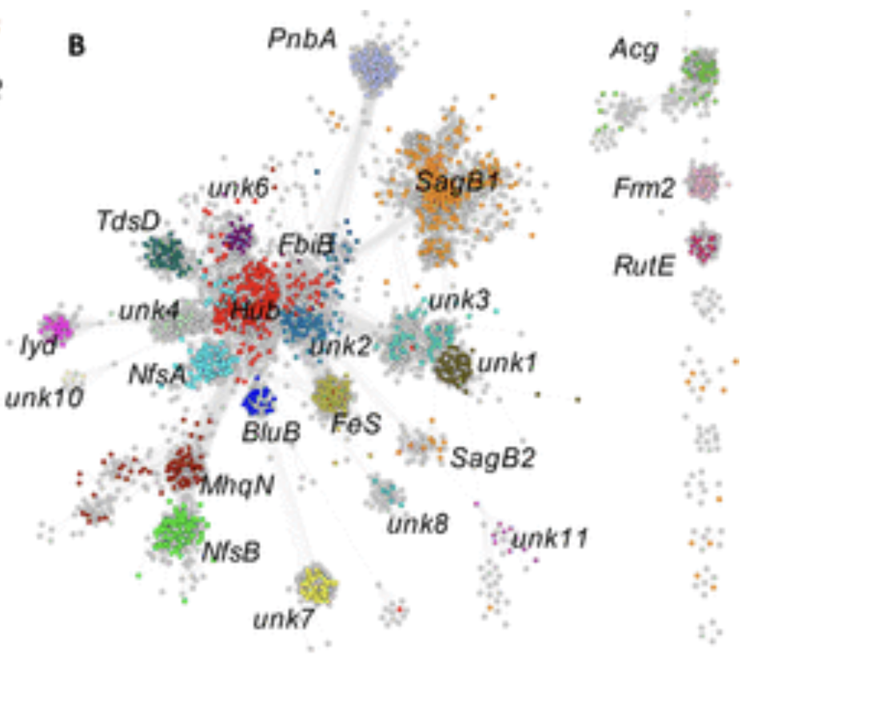
Nitro reductase superfamily
“nitro reductase” enzymes
Flav mononucleotide (FMN) cofactor dependent
Use bi-bi redox reaction mechanism
Catalytic Activities
- Nitroaromatic
- Enone reduction
- Quinone reduction
- Fatty Acid reduction
- Dehalogenation
- Flavin Fragmentation
Copp JN, Akiva E, Babbitt PC, Tokuriki N. et al. 2018
Notes:
IYD (Iodotyrosine Deiodinase) belongs to a large enzyme family called the Nitroreductase superfamily. This family has over 24,000 enzymes that all: 1. Use FMN (Flavin Mononucleotide) as their cofactor
2. Use a ping-pong mechanism where electrons go in, then out. The image shows a Sequence Similarity Network. So, each cluster is a group of related enzymes. Even though all these enzymes share the same cofactor and general mechanism, they do different chemistries like (l*ist the activities*). Our enzyme does dehalogenation (removing halogens). The important thing about is that it is one of only 2 enzymes that can do dehalogenation.

Slide 3
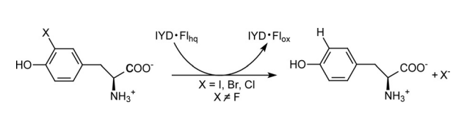
IYD subgroup of NTR superfamily perform bioremediation
Iodotyrosine (IYD) performs reductive dehalogenation
Reduction step removes halogen atom
Replaces with H atom
Thyroid Synthesis
Environmental Remediation
Mukherjee A, Rokita et al. 2015
Notes:
"IYD (Iodotyrosine Deiodinase) removes halogen atoms from tyrosine using electrons. The reaction: 1. Takes in halo-tyrosine (tyrosine with I, Br, or Cl attached). 2. Uses reduced FMN (Flavin Mononucleotide) as electron donor. 2. Releases tyrosine + halide ion + oxidized FMN
It is important to note that it works Iodine, Bromine, and Chlorine, but NOT Fluorine. the C-F (carbon-fluorine) bond is too strong.
It has 2 main applications:
Thyroid synthesis - recycles iodine for making thyroid hormones
Bioremediation - can be engineered to potentially clean up halogenated pollutants and detoxify them.

Slide 4
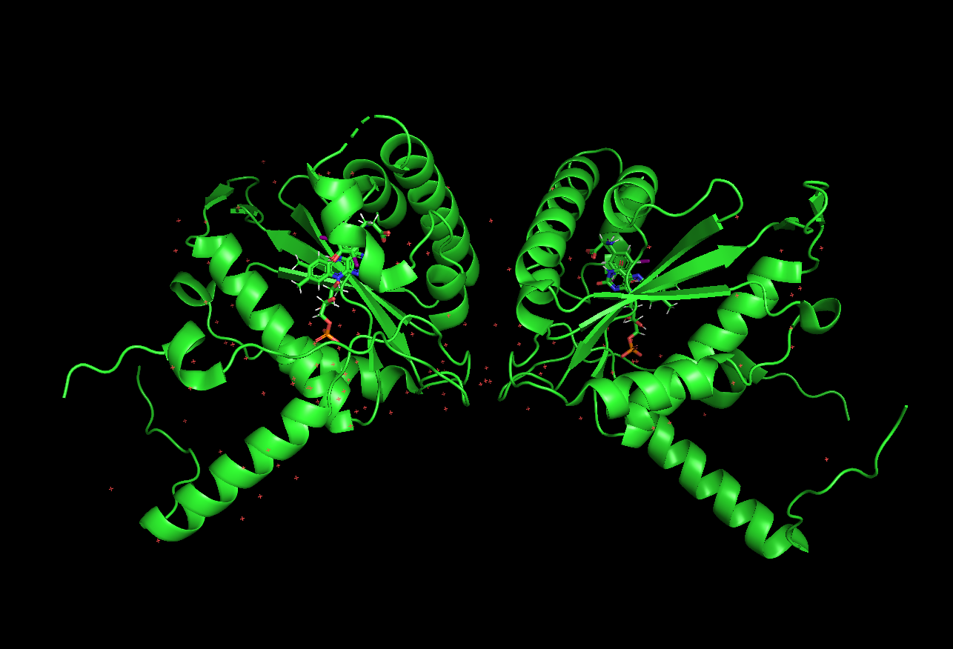
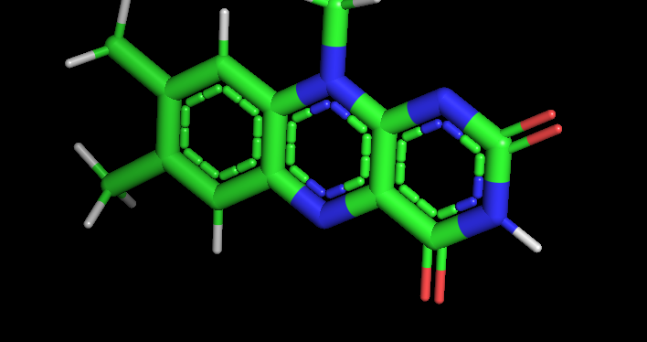
Reductive dehalogenation is catalyzed by FMN cofactor
FMN cofactor = primary electron donor to substrate
Two single-electron transfer steps
Unstable substrate radical undergoes reductive cleavage releasing halogen atom
PDB 5KO8 haliscomenobacter hydrossis iodotyrosine deiodinase (IYD) bound to FMN and mono-iodotyrosine (I-Tyr)
Notes:
The FMN (Flavin Mononucleotide) cofactor is what actually donates electrons to break the carbon-halogen bond. The crystal structure on the right shows FMN and the substrate I-Tyr (iodotyrosine).
An important thing to mention is the isoaxollazine ring of the cofactor. It has nuclei which interact with environment (substrate and protein residues) to help facilitate electron transfer whether it is single or double electron transfer.

Slide 5
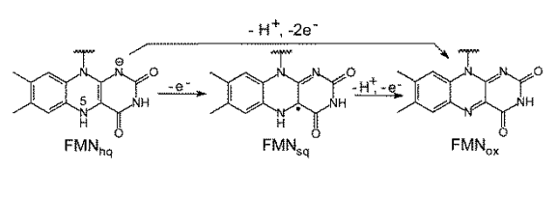
FMN Characterization
Hydroquinone (FMN_{hq}) = reduced form
Semiquinone (FMN_{sq}) = one electron reduced form
Oxidized (FMN_{ox}) = oxidized form
Mukherjee A, Rokita et al. 2015
Notes:
It has 3 forms:
1. hydroquinone form is fully reduced , it has 2 extra electrons and it is ready to donate
2. semiquinone form is half-reduced, it has 1 extra electron and this is a radical. That is the state we mainly study in this project.
3. oxidized form is the one with no extra electrons and that is basically the resting state for FMN

Slide 6
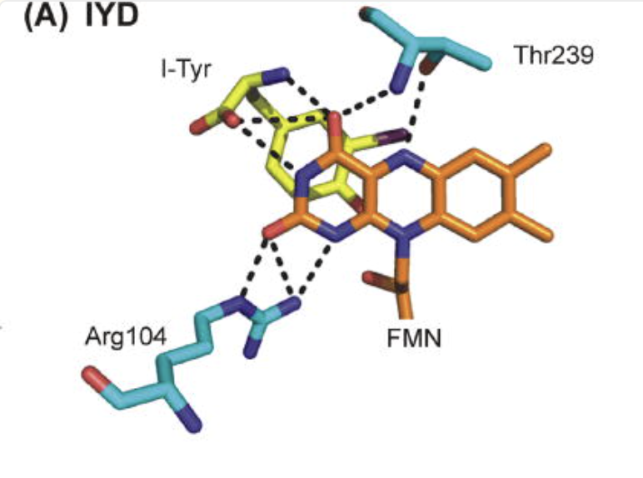
Polar coordination is necessary for semiquinone stabilization
2
1
Active site configuration
side chain functional groups and isoalloxazine ring of flavin bond formation
3
Sun Z, Su Q, Rokita et al. 2017
Notes:
Threonine that sits below and bonds to the N5 position of isoaxollized ring
Zwitterion of the substrate forms a bond to the N3 and O4 locations on the cofactor
Guanidine side group forming a bond with N1 and O2 on the flavin

Slide 7
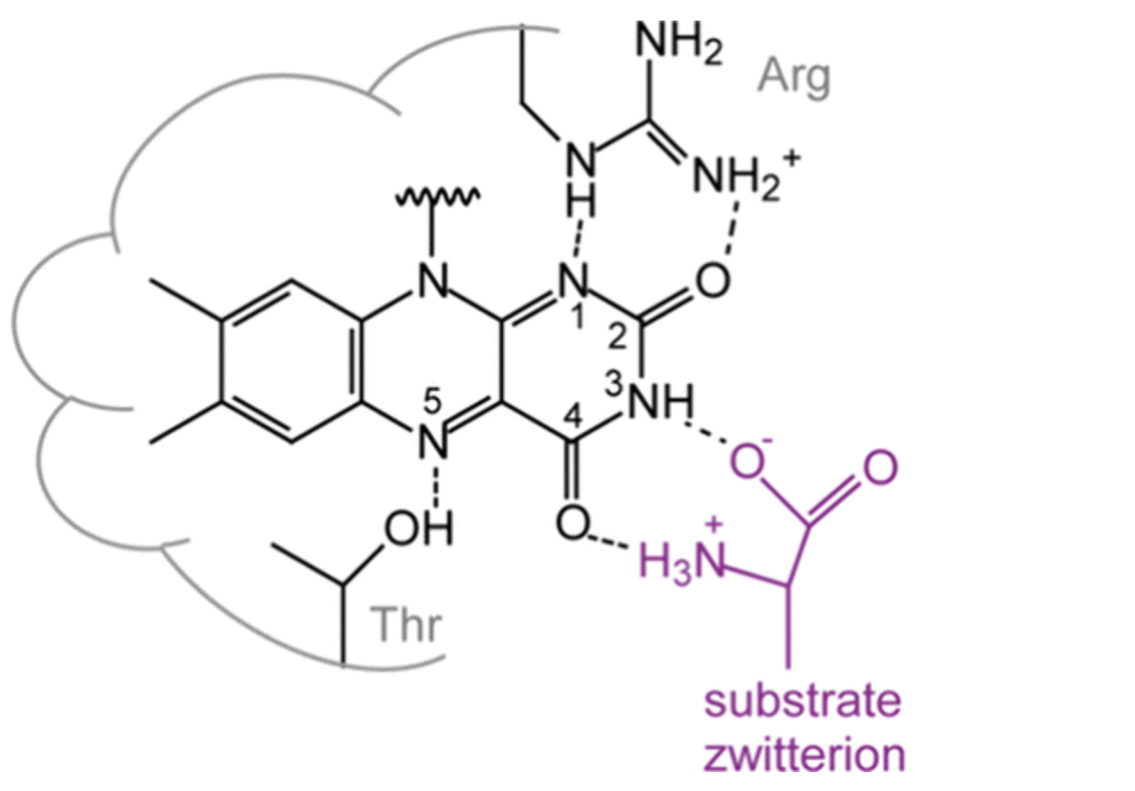
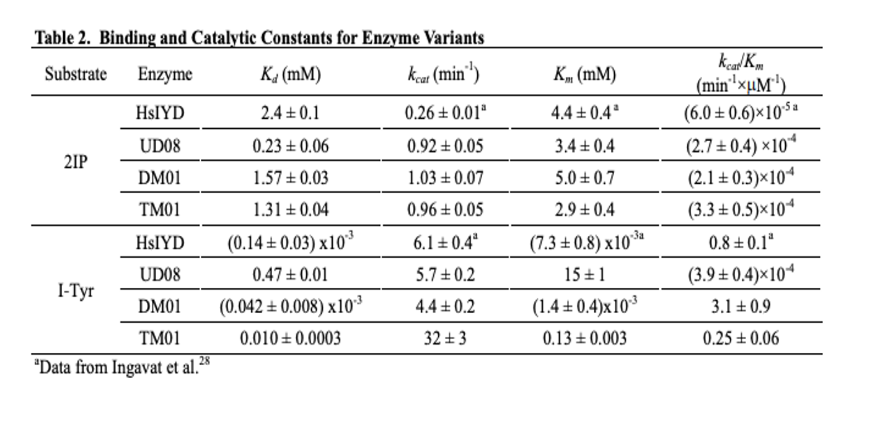

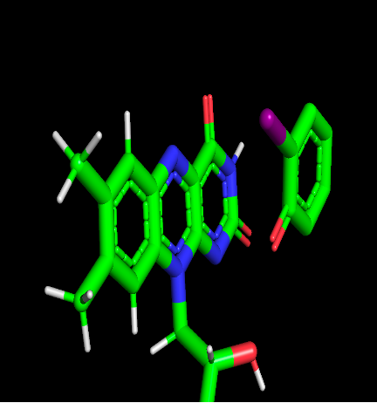
Catalytic efficiency and semiquinone stabilization diminish without key interactions
PDB 5KRD: FMN cofactor interacting with 2IP (substrate that lacks zwitterion)
Lemen D, Rokita et al. 2024
Notes:
A study performed by Rokita et al characterized the catalytic efficiency of the enzyme in the presence of different substrates. The first (2IP) is 2-iodophenol which lacks zwitterion that the other substrate, (IYR) iodotyrosine has. The lack of interactions between the substrate and the cofactor correlates to a decrease in catalytic efficiency illustrated by the decrease in kcat/km rate.

Slide 8
Goal
Use DFT calculation to analyze electron density of FMN and MD Simulation to obtain the geometry of catalytic environment of Transition State of IYD
Notes:
We are using DFT to see if we can better understand the electron distribution of the Flavin cofactor in hopes that it will give researchers a better understanding of what is happening in the system during bond formation with other residues especially in its radical Transition state. We want to know the reaction mechanism of FMN and flavoproteins. We are performing an MD simulation to get configuration of the active site geometry of the TS state so we can see bond distances and angles of the active site of the enzyme during its crucial step.

Slide 9
Methods
Active site geometry optimization
Molecular Dynamics Simulation (MD Simulation)
Active Site generation
Electron Density Analysis
DFT calculation of FMN cofactor

Slide 10
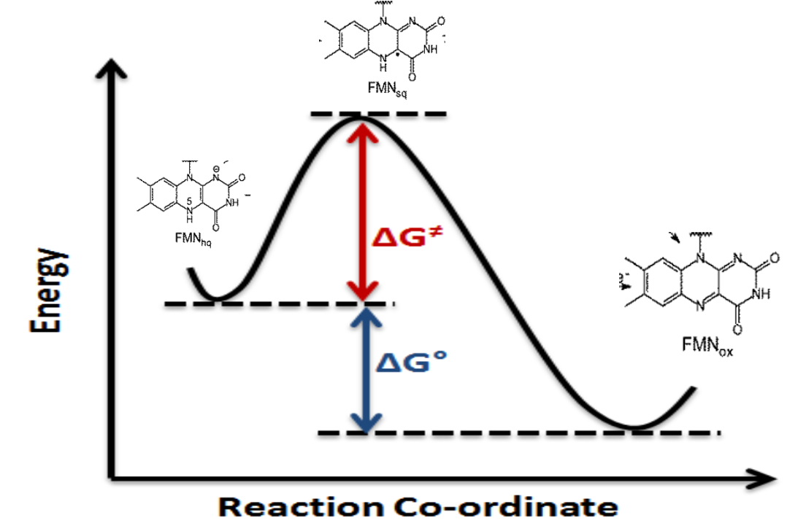
Molecular Dynamics Simulation
Simulate the reaction pathway of enzyme w/ cofactor and substrate bound
Get "snapshots" of intermediate Transition State (semiquinone form)
Notes:
We can starrt with either the oxidized FMN structure and work backwards to get to transition state gemetry or begin at reduced flavin and work forward through energy landscape to get the TS state.

Slide 11
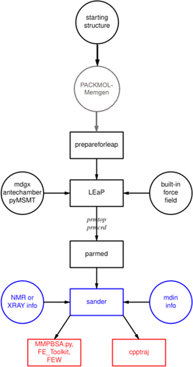
Molecular Dynamics Simulation Tools
Amber Tools (Assisted Model Building and Energy Refinement)
Collection of programs that are designed to. . .
Facilitate system setup
Run MD simulations
Trajectory analysis for biomolecules
Merz Jr. et al. 2023
Notes:
Typical workflow of AmberTools usage
Begin with a starting structre
Use PACKMOL-Memgen to build complex (protein systems for MD simulation)
Prepare PDB files for LEaP (Link, Edit, and PArm) program for automated MD simulation
LEaP program parameterizes by cnnecting molecules to force fields to assign atom types, charges and bond paramters
- Adds water boxes and neutralizes the system by adding counterions
- Creates topology file and coordinate files for the system during steps
5. Post-processing tool is parmed which edits molecular system topologies and parameters before MD simulation without needing to rebuild the system
6. Simulation engine of the MD simulation
7. Generate trajectories and topolgy files into datasets

Slide 12
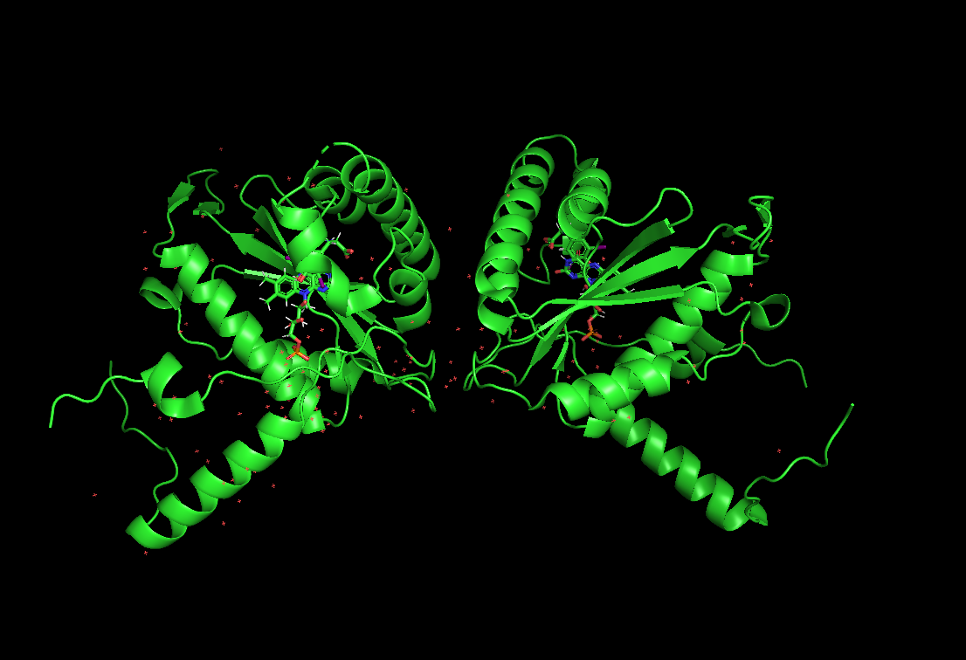
Molecular Dynamics Simulation
Input : IYD structure (oxidized FMN)
Removed water molecules
Parsed structure into parts
FMN cofactor
Substrate
Protein backbone
3. Parameterized non-standard parts
(AMI-BCC method)
Notes:
AMI-BCC method (Austin Model 1-Bond Charge Correction): Used instead of QM calculations to generate basic atomic charges of the ligands
Used to emulate the accuracy of Hartree-Fock electrostatic fit charges

Slide 13
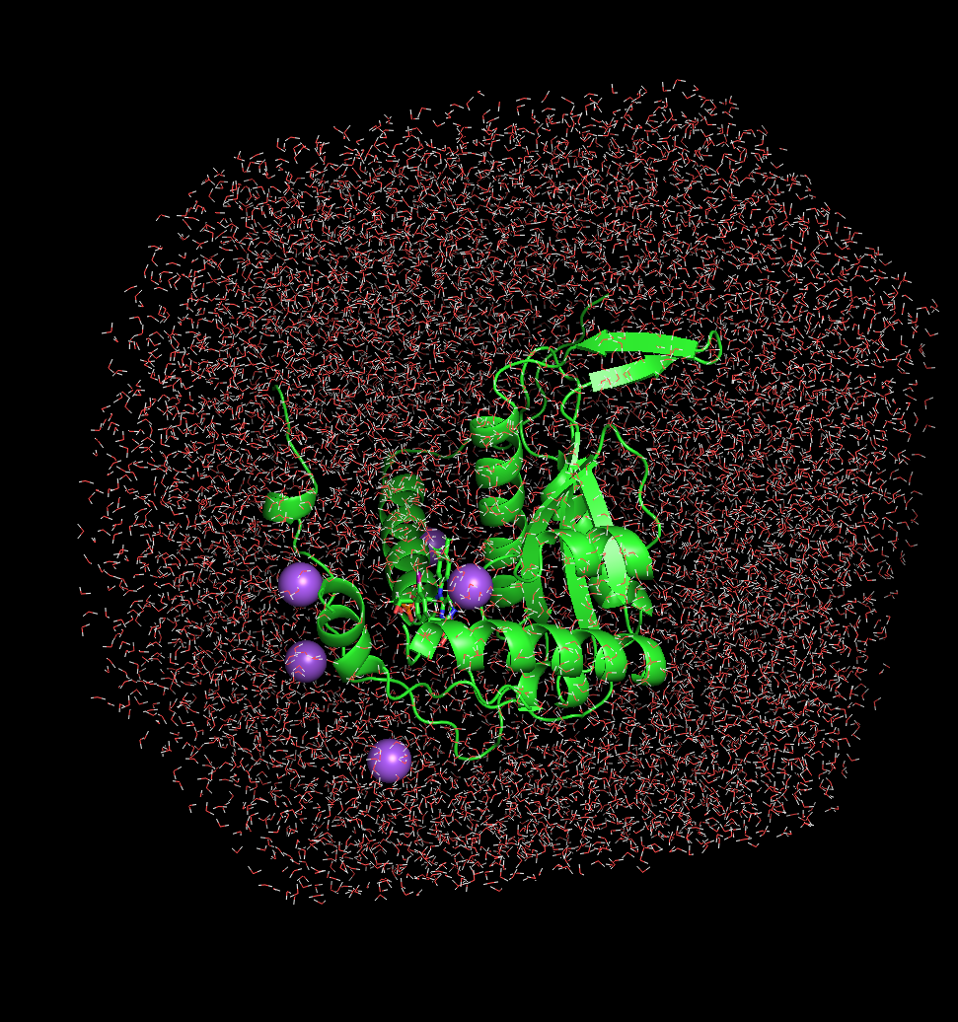
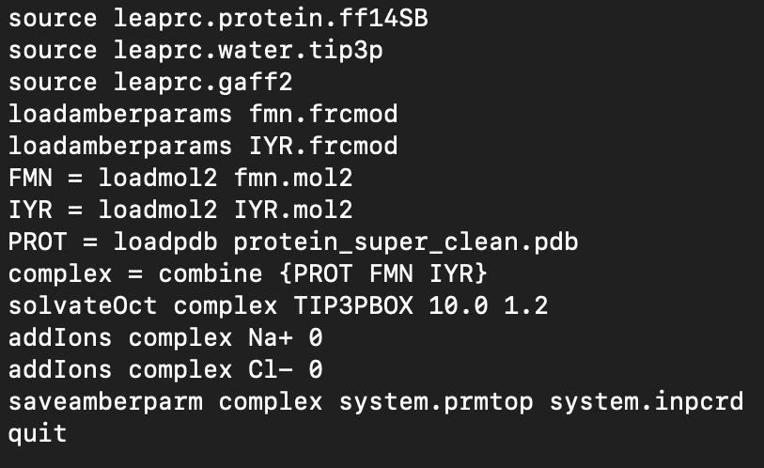
Build system
Solvation (generate solvent environment)
water box (10 x 10 x 10 Å)
Add Ions to neutralize system

Slide 14
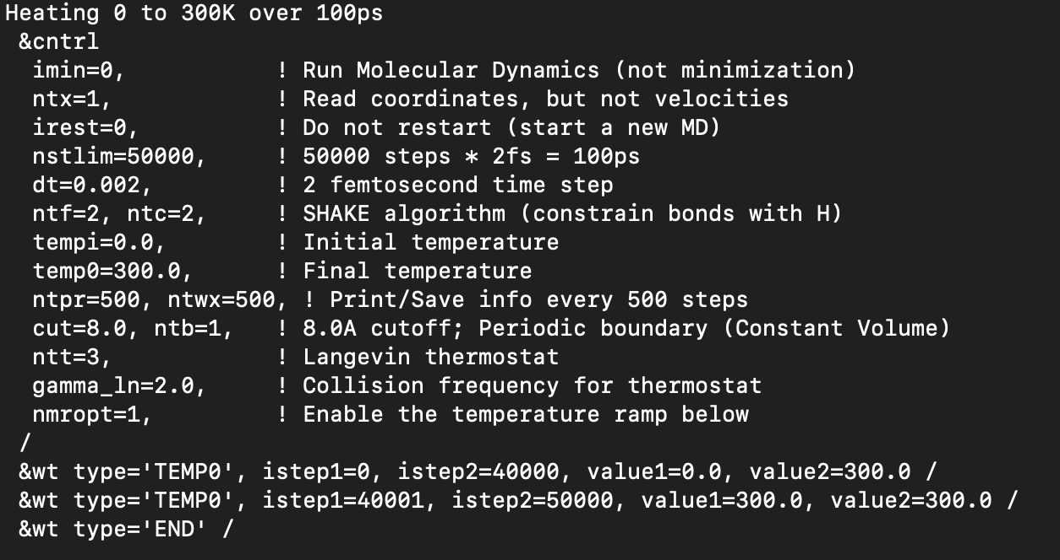
Heating the system
Heated from 0 K 300 K
100 ps
2 femtosecond time steps (50,000 steps)
Constant volume of complex (less than 8 Å)
Langevin thermostat
Adds stochastic collision term
Told the system to remain at 300K once we reach that temperature

Slide 15
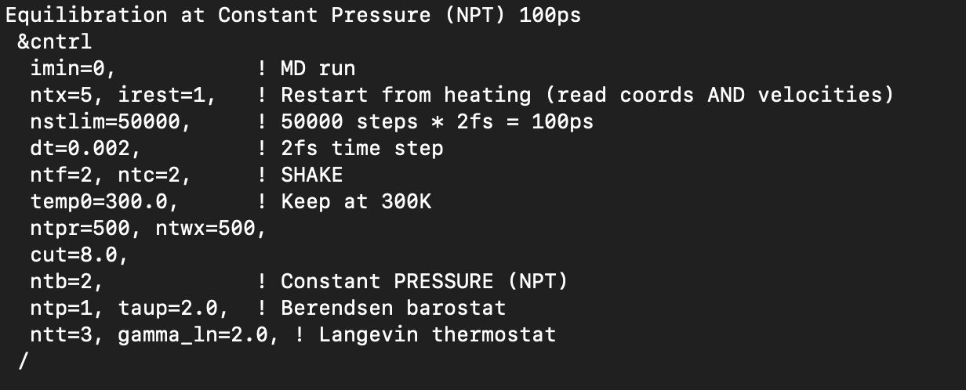
Equilibration
Constant Pressure – Berendsen thermostat
- isotropic position scaling
Constant Temperature -
Langevin thermostat

Slide 16
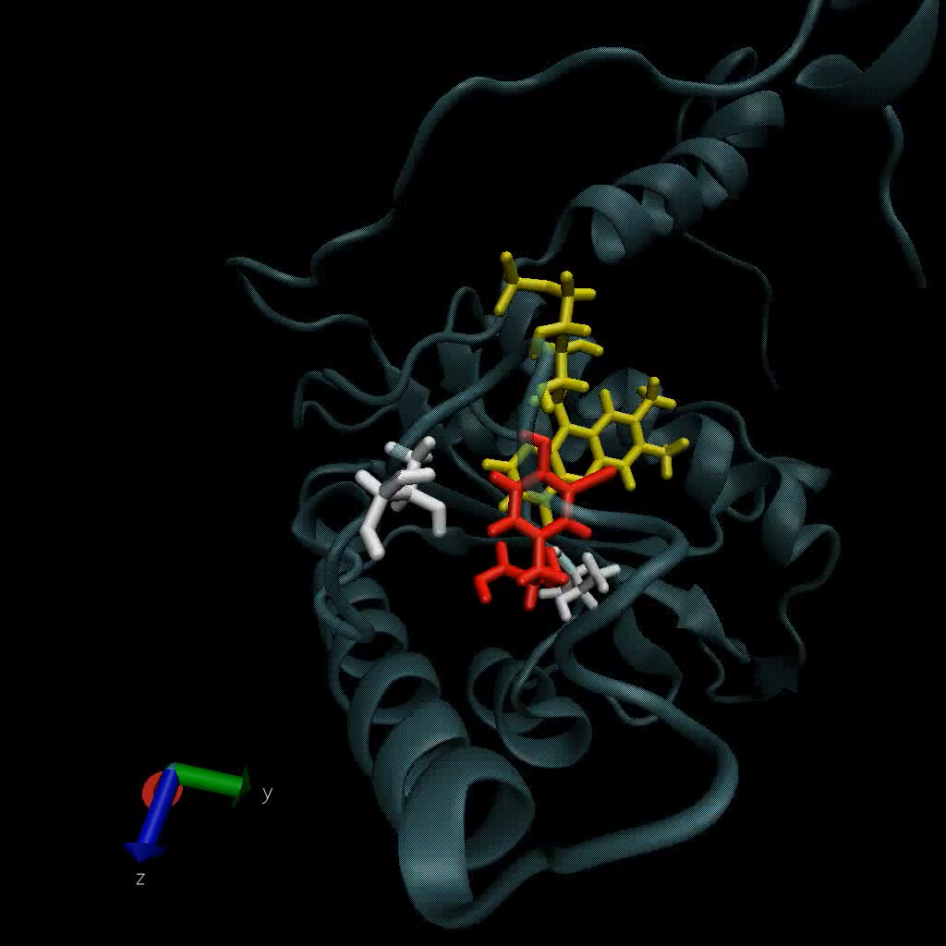
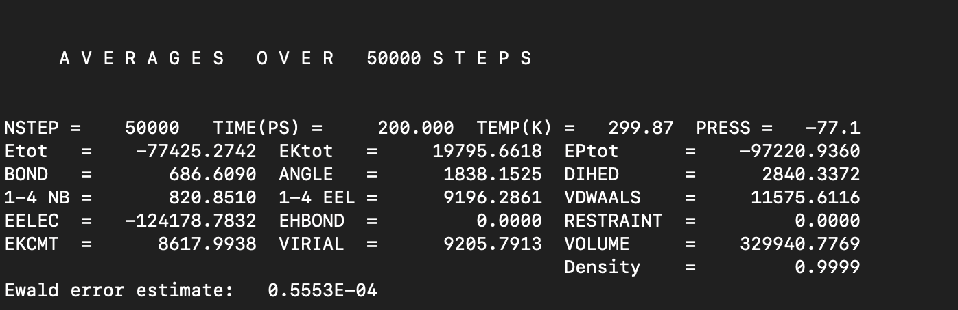
Production

Slide 17
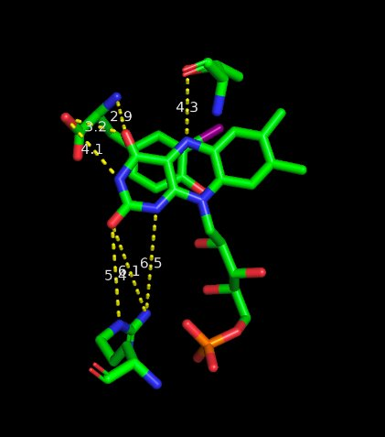
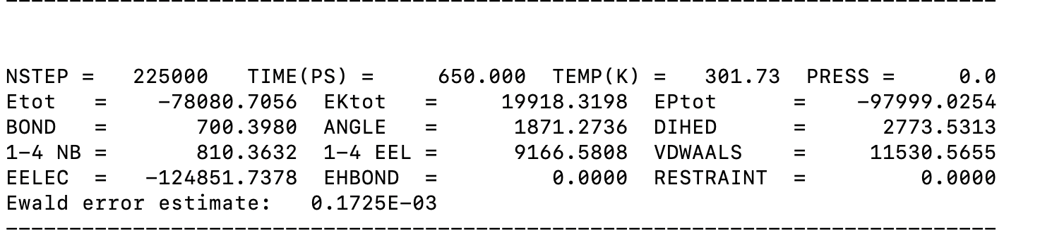
Snapshot of lowest Epot structure in energy landscape
Notes:
Although we were warned to not just go based off the lowest potential energy snapshot, I had to. I chose the snapshot with the lowest energy potential to analyze the bond distance and angles of key residues and the interactions between the FMN ring as well as the substrate interaction with FMN ring.

Slide 18
Limitations and Future Directions for MD simulation
What was missing?
Did not have experimental data of radical Transition State geometry active site to validate theoretical yield
Not enough information to validate choice of snapshot during MD simulation (what are we looking for?)
What comes next?
Could be starting position for in-silico protein design if active site geometry is known
Calculate electron density of FMN in TS and compare to research with FMNsq electron density
Increase Equilibriation step for more time steps to further investigate energy landscape

Slide 19
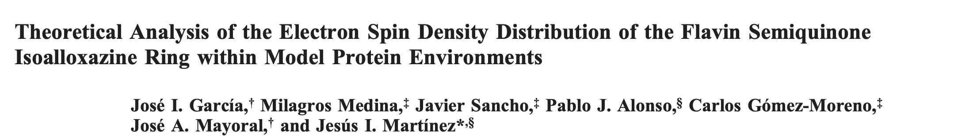
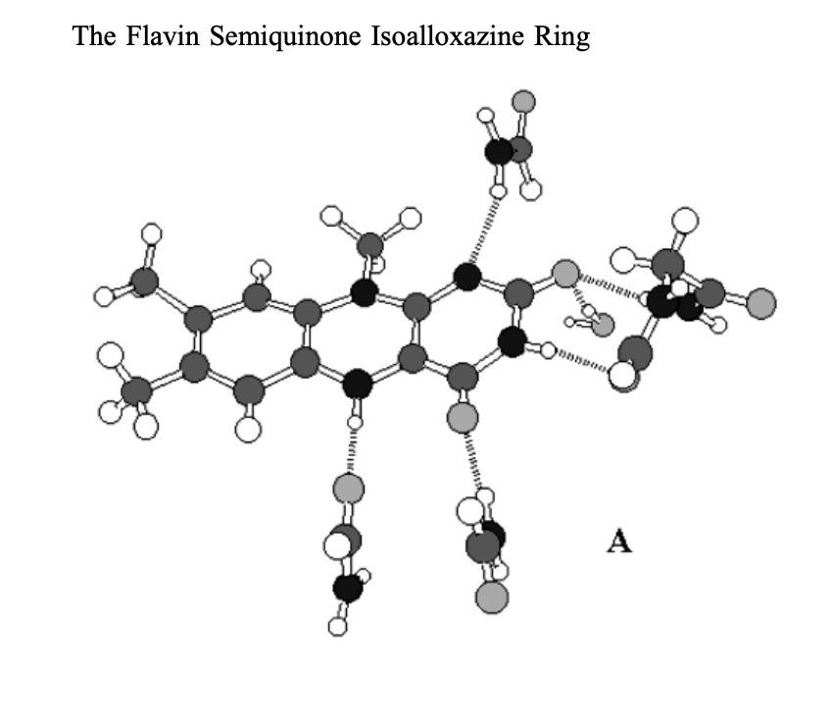
Past research has used DFT study the FMN semiquinone state
Theoretical Method
Gaussian 98 program
B3LYP functional
EPR – II basis set
〈S2〉expectation values range from 0.753 to 0.773
Long range environmental effects estimated w/ self-consistent isodensity polarizable continuum model (SCIPCM)
Notes:
We can see if our results match or come close to what the researchers in this paper had for the electron density of the FMN cofactor in semiquinone radiacal state
Paper from 2021 which uses DFT calculations to understand the Spin Density Distribution of FMNsq.
Figure is an image of Neutral lumiflavin semiquinone surrounded by the “inplane” interactions considered in the calculations.

Slide 20
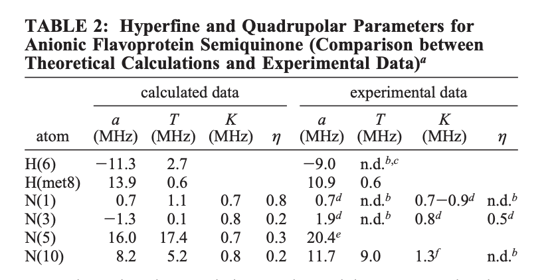
Results from the paper
Obtained theoretical values for the hyperfine interaction parameters of all of the nuclei of the flavin ring with the unpaired spin
2. Predicted interaction parameters were compared with experimental values
Notes:
Based on the results. . . they do not solve the assignment problem in their calculations
Theoretical data of a reported on N1 indicates it should be the nucleus (lowest a value)
2. Hyperfine interactions of N(5) has not been experimentally deteced in flavoproteins, but theoretical calculations indicate N(5) must be nucleus w strongest hyperfine interaction
Problems
Calculations underestimate the impact of the anisotropy of the interaction
2. The experimentally calculated values are in question because the tumbling of flavin model complexes in water at room temperature is not fast enough to average completely anisotropic hyperfine contribution
Alpha value is hyperfine coupling constant which quantifies the interaction between an unpaired electron and nuclear spin

Slide 21
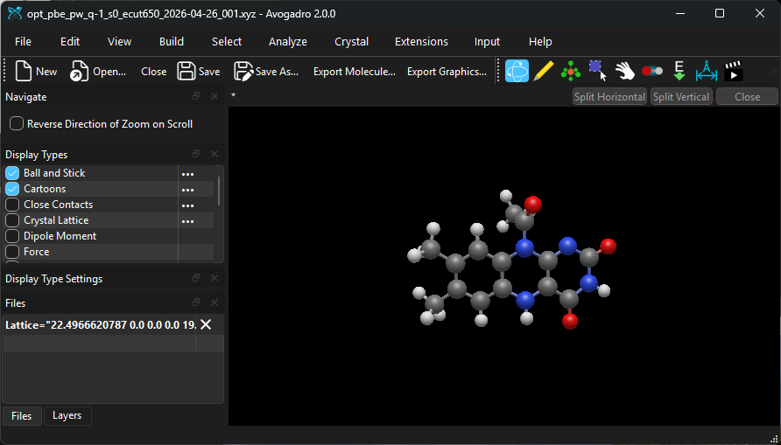
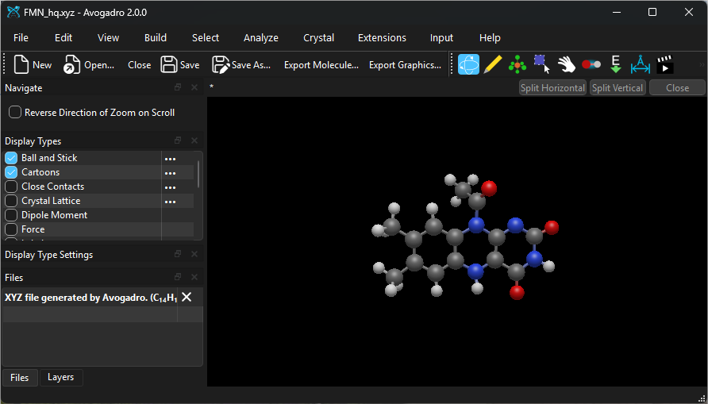
Preliminary Optimizations of FMN
Design Process
Started with FMN hq structure
Created .xyz chemical file in Avogadro to serve as an ASE input to be passed through GPAW
Tested system with just FMN hq before moving on to FMN sq or FMN ox

Slide 22
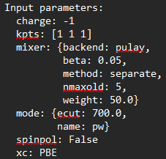
DFT Methodology
Using GPAW and ASE with:
BFGS (Broyden–Fletcher–Goldfarb–Shanno) algorithm for geometry optimization
PBE (Perdew–Burke–Ernzerhof) functional for Calculating Forces
Kabsch Algorithm for RMSD of molecules
Used recommended mixing parameters from GPAW documentation
Conducted full geometry optimizations for energy cutoffs of 450, 500, 550, 600, 650, 700 eV
Broyden et. al., Perdew et. Al., Kabsch et. Al.

Slide 23
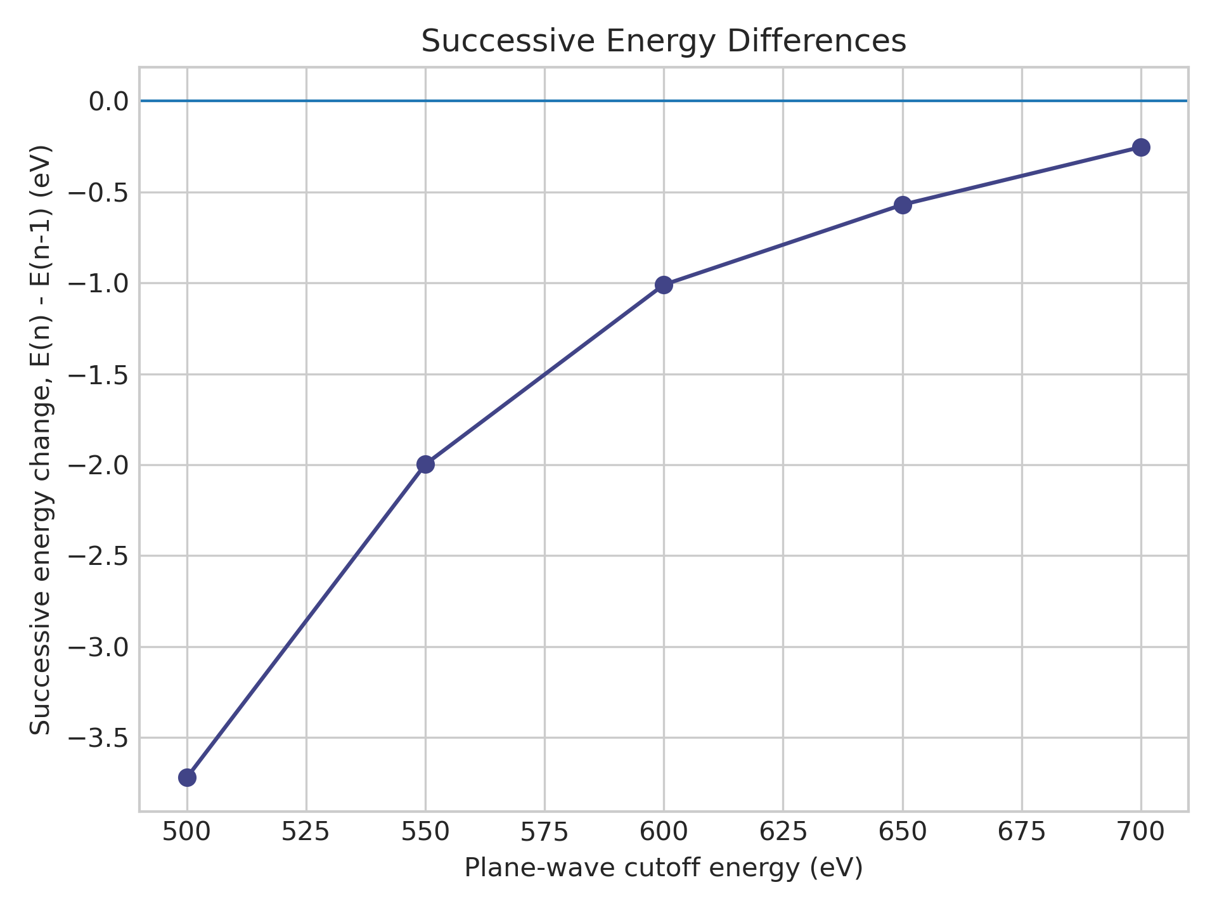
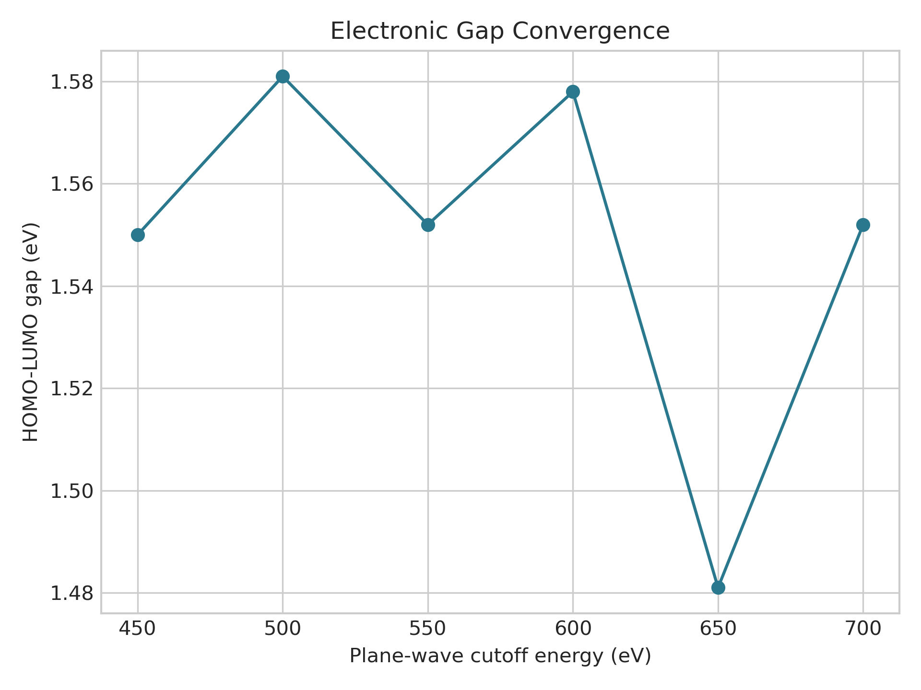
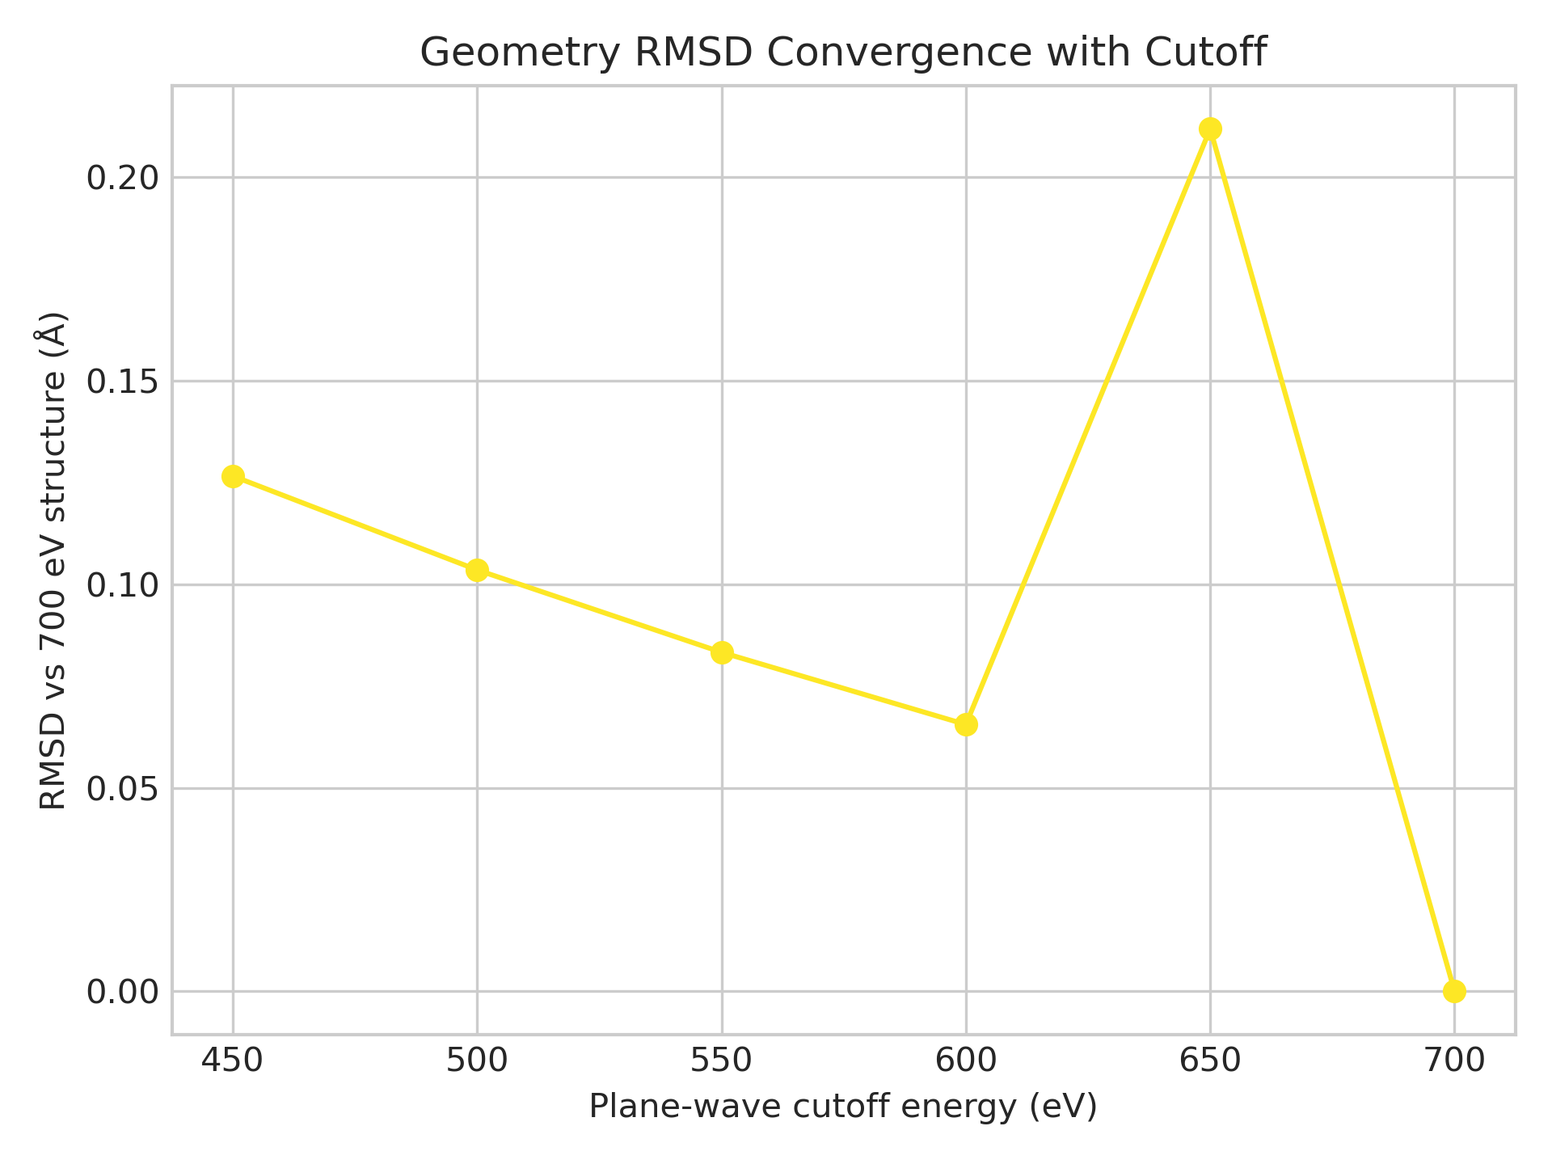
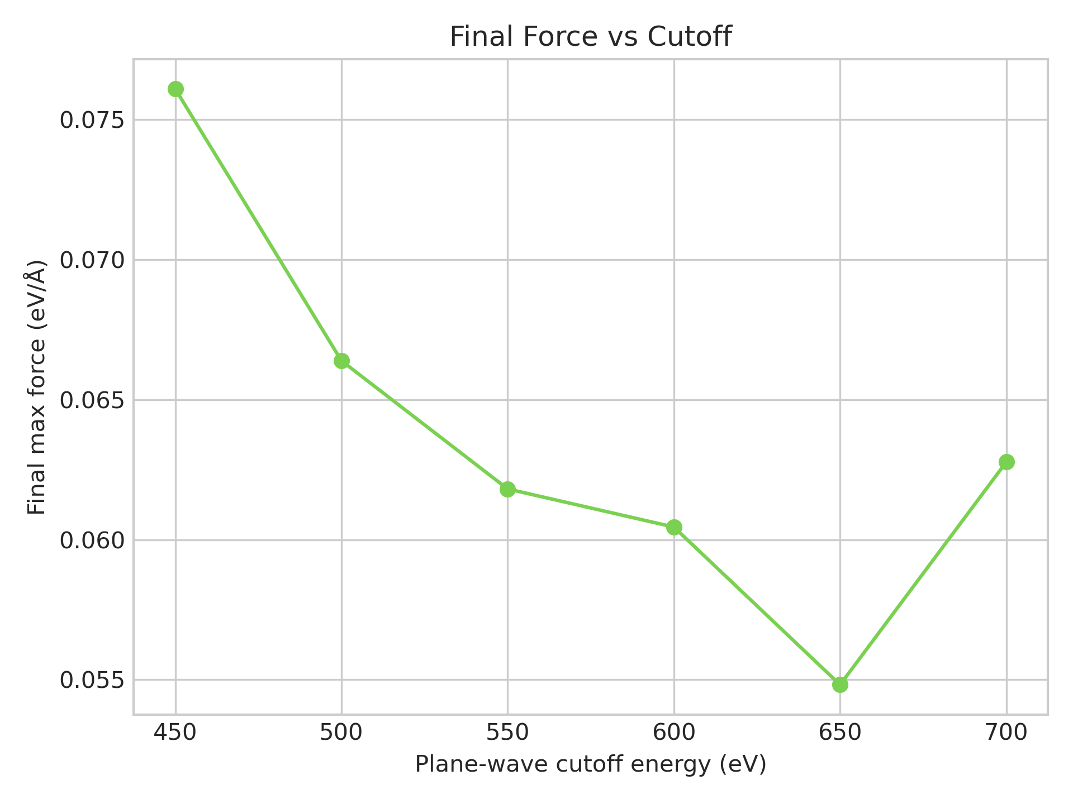
FMN HQ Convergence Results
Introduction text
Energy Cutoff
Shows approach of convergence
HOMO/LUMO Gap
Stays consistently around ~1.55eV
RMSD of Molecules
Decrease with spike at 650 eV
Maximum Force
Max force stays below 0.065 eV/A for higher eCutoff parameters

Slide 24
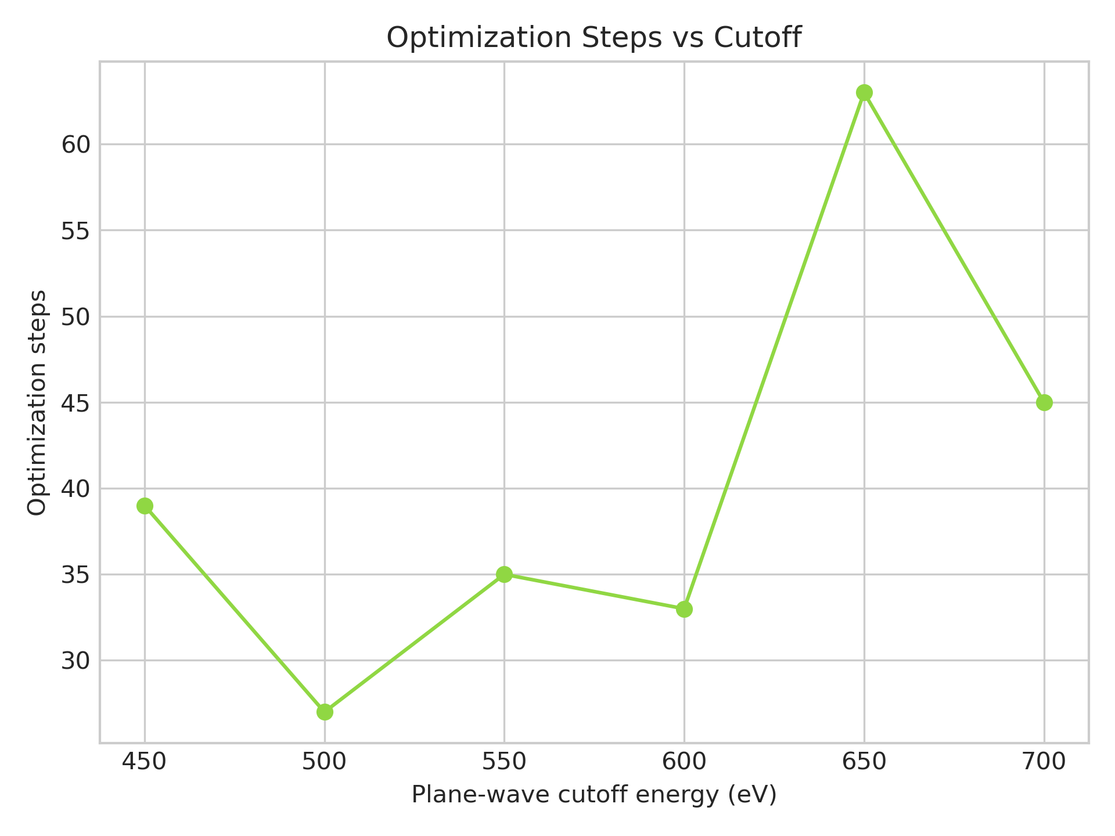
DFT Conclusions
Structure is converging
Reaching point of diminishing returns around 700 eV
650 eV eCutoff abnormality likely got stuck in another local basin
600-650 eV likely to be the "sweet spot" for the cutoff energy

Slide 25
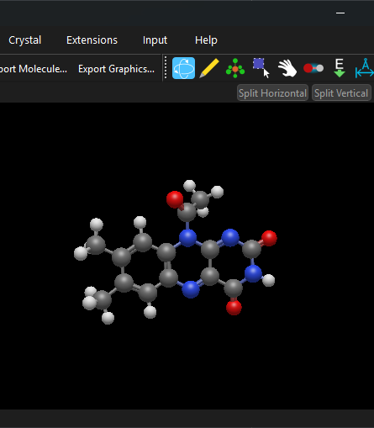
Future DFT Objectives
What comes next?
Model other structures relevant to process
  FMN sq, FMN ox, DIT, TIT
Map electron density regions
Move forward with Meta-GGA calculations (SCAN preferred at the moment)
Confirm 650 eV is indeed an anomaly
Move on to more physically realistic environment

Slide 26
References
Bobyk KD, Ballou DP, Rokita SE. Rapid kinetics of dehalogenation promoted by iodotyrosine deiodinase from human thyroid. Biochemistry. 2015 Jul 28;54(29):4487-94. doi: 10.1021/acs.biochem.5b00410. Epub 2015 Jul 20. PMID: 26151430; PMCID: PMC4938124.
Copp JN, Akiva E, Babbitt PC, Tokuriki N. Revealing Unexplored Sequence-Function Space Using Sequence Similarity Networks. Biochemistry. 2018 Aug 7;57(31):4651-4662. doi: 10.1021/acs.biochem.8b00473. Epub 2018 Jul 27. PMID: 30052428.
Mukherjee A, Rokita SE. Single Amino Acid Switch between a Flavin-Dependent Dehalogenase and Nitroreductase. J Am Chem Soc. 2015 Dec 16;137(49):15342-5. doi: 10.1021/jacs.5b07540. Epub 2015 Dec 4. PMID: 26616824; PMCID: PMC4684082.
Lemen D, Rokita SE. Polar Interactions between Substrate and Flavin Control Iodotyrosine Deiodinase Function. Biochemistry. 2024 Sep 17;63(18):2380-2389. doi: 10.1021/acs.biochem.4c00357. Epub 2024 Aug 30. PMID: 39213510; PMCID: PMC11408085.
Case DA, Aktulga HM, Belfon K, Cerutti DS, Cisneros GA, Cruzeiro VWD, Forouzesh N, Giese TJ, Götz AW, Gohlke H, Izadi S, Kasavajhala K, Kaymak MC, King E, Kurtzman T, Lee TS, Li P, Liu J, Luchko T, Luo R, Manathunga M, Machado MR, Nguyen HM, O'Hearn KA, Onufriev AV, Pan F, Pantano S, Qi R, Rahnamoun A, Risheh A, Schott-Verdugo S, Shajan A, Swails J, Wang J, Wei H, Wu X, Wu Y, Zhang S, Zhao S, Zhu Q, Cheatham TE 3rd, Roe DR, Roitberg A, Simmerling C, York DM, Nagan MC, Merz KM Jr. AmberTools. J Chem Inf Model. 2023 Oct 23;63(20):6183-6191. doi: 10.1021/acs.jcim.3c01153. Epub 2023 Oct 8. PMID: 37805934; PMCID: PMC10598796.
Kabir MP, Ghosh P, Gozem S. Electronic Structure Methods for Simulating Flavin's Spectroscopy and Photophysics: Comparison of Multi-reference, TD-DFT, and Single-Reference Wave Function Methods. J Phys Chem B. 2024 Aug 8;128(31):7545-7557. doi: 10.1021/acs.jpcb.4c03748. Epub 2024 Jul 29. PMID: 39074870; PMCID: PMC11317985.
Sun Z, Su Q, Rokita SE. The distribution and mechanism of iodotyrosine deiodinase defied expectations. Arch Biochem Biophys. 2017 Oct 15;632:77-87. doi: 10.1016/j.abb.2017.07.019. Epub 2017 Jul 31. PMID: 28774660; PMCID: PMC5665059.
García, J. I., Medina, M., Sancho, J., Alonso, P. J., Gómez-Moreno, C., Mayoral, J. A., & Martínez, J. I. (2002). Theoretical Analysis of the Electron Spin Density Distribution of the Flavin Semiquinone Isoalloxazine Ring within Model Protein Environments. The Journal of Physical Chemistry A, 106(18), 4731-4739. DOI:
Hohenberg, P.; Kohn, W. Inhomogeneous Electron Gas. Phys. Rev. 1964, 136, B864–B871
Kohn, W.; Sham, L. J. Self-Consistent Equations Including Exchange and Correlation Effects. Phys. Rev. 1965, 140, A1133–A1138
Perdew, J. P.; Burke, K.; Ernzerhof, M. Generalized Gradient Approximation Made Simple. Phys. Rev. Lett. 1996, 77, 3865–3868
Payne, M. C.; et al. Iterative Minimization Techniques for ab Initio Total-Energy Calculations. Rev. Mod. Phys. 1992, 64, 1045–1097
Broyden, C. G. The Convergence of a Class of Double-Rank Minimization Algorithms. J. Inst. Math. Appl. 1970, 6, 76–90
Mortensen, J. J.; Hansen, L. B.; Jacobsen, K. W. Phys. Rev. B 2005, 71, 035109
Enkovaara, J.; et al. J. Phys.: Condens. Matter 2010, 22, 253202
Larsen, A. H.; et al. J. Phys.: Condens. Matter 2017, 29, 273002

Slide 27
Thank You!
Anar Nuruzada, Logan Kuhn, Gilbert Otoo
Understanding Redox Chemistry of FMN semiquinone with DFT and MD simulation
Notes:
Tip: There’s no need to include WWW or HTTPS in front of your URL.

